Slide 1
Bulls and cows
Team “Voss”

Slide 2
Team “Voss”
Anton Velikov (antata_iv) https://softuni.bg/users/profile/show/antata_iv
Asen Santev (trysth) https://softuni.bg/users/profile/show/trysth
Kostadin Kanev (kktexx) https://softuni.bg/users/profile/show/kktexx
Krasimir Bonev (krasimir_bonev) https://softuni.bg/users/profile/show/krasimir_bonev

Slide 3
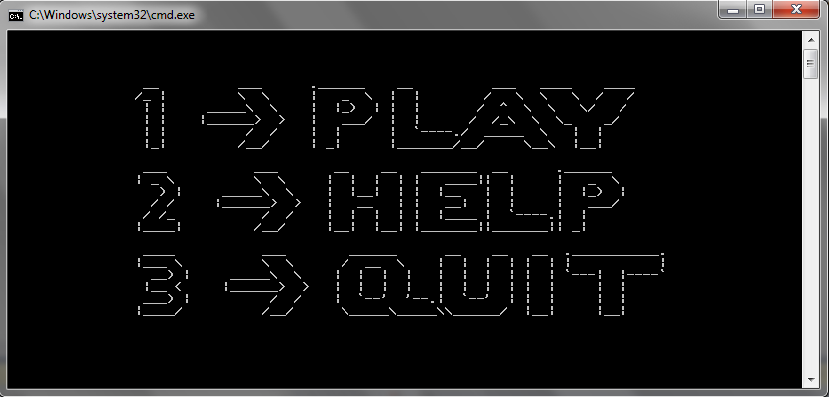
Bulls and cows

Slide 4
GitHub Repository

